Slide 1
Mobile Reviews NLP and Clustering
Morooj Aldeeb & Afnan Alsirhani

Slide 2
Introduction
We utilized unsupervised machine learning techniques to gain more insights into mobile products reviews of amazon.
The dataset contains approximately 417000 records which explain customers’ ratings , sentiments and reviews over a set of predefined mobile products

Slide 3
objective
Using unsupervised machine learning techniques along with NLP methods to understand customers’ sentiments over different products.
Explain the differences between customers’ reviews based on latent topics contained within to better tailor future marketing and product improvements.

Slide 4
METHODOLOGY
EDA
Dimensionality Reduction
Singular Value Decomposition
Principal Component Analysis
Topic Modeling
Latent Semantic Analysis
Clustering (K-Means)
Classification (SGB classifier, Logistic regression ,Naive Bayes)
Wrangling
NLP Preprocessing
Tokenization
Lemmatization/Stemming
Emoji Conversion
Stop Words Removal
Entropy
Vectorization (Count/TF-IDF)
LDA ( Latent Dirichlet allocation )

Slide 5
Metadata
The data source used was the Kaggle website.
Data frame shape:-
Original data: 413840 observations and 6 columns
After EDA: 226000 observations and 6 columns
After Feature engineering: 63000 observations and ~ 6000 columns

Slide 6
Tools and Libraries
spaCy
Pandas
gensim
Python
TextBlob
NLTK
Corex
Wordcloud
ScatterText

Slide 7
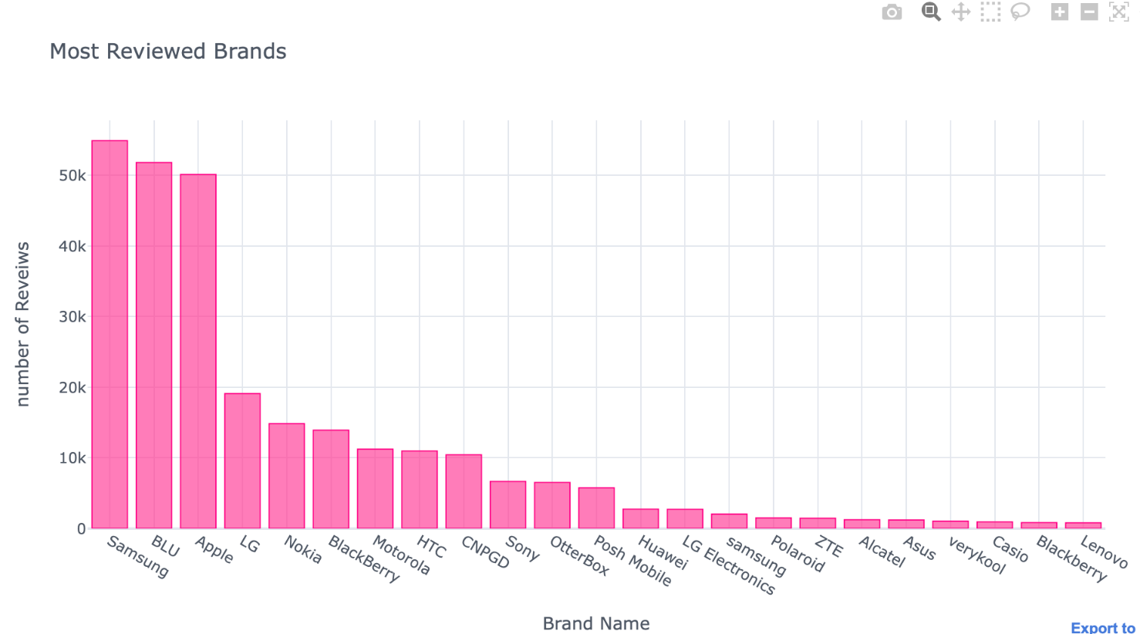
Data Understanding

Slide 8
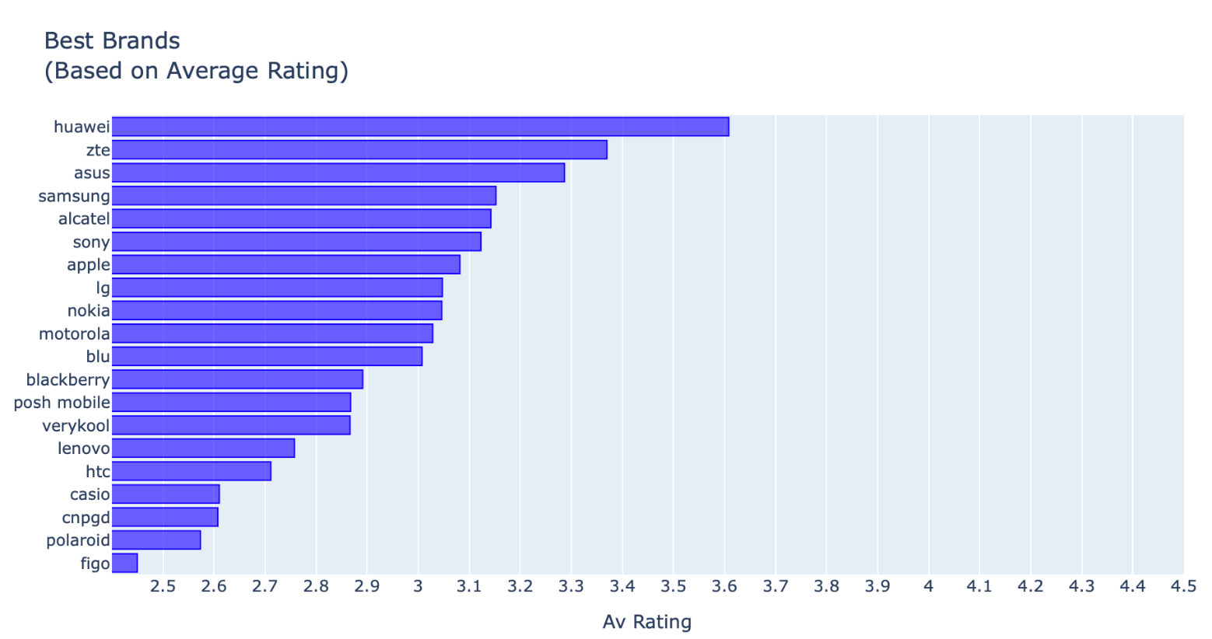
Data Understanding

Slide 9
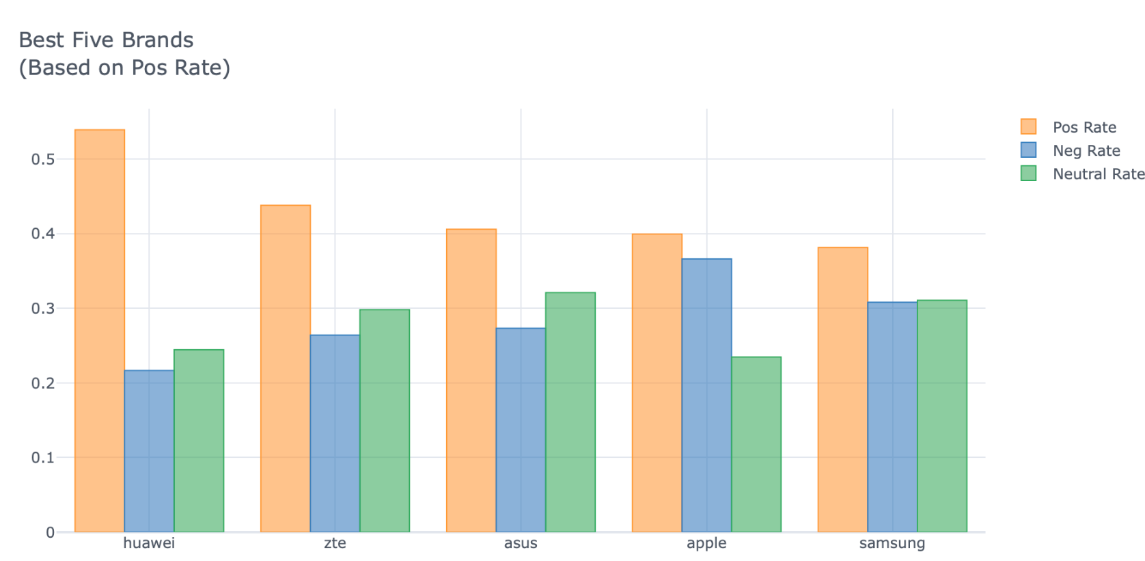
Data Understanding

Slide 10
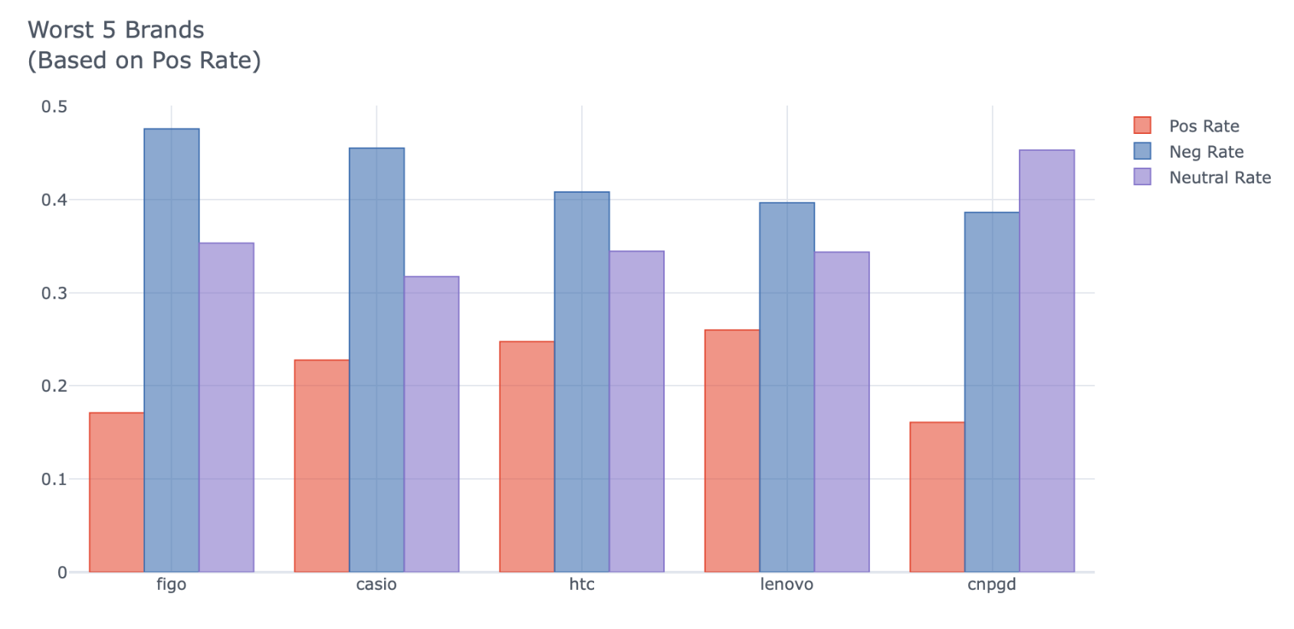
Data Understanding

Slide 11
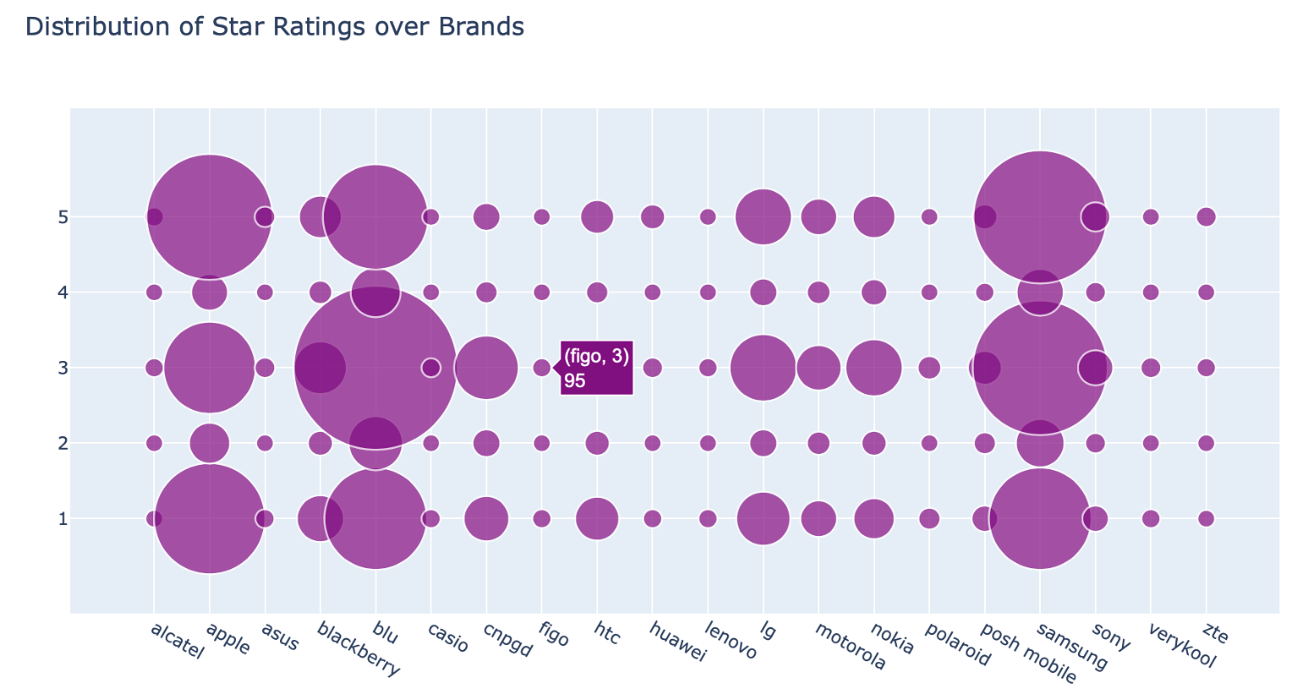
Data Understanding

Slide 12
Feature Engineering
Features selection:
We removed most common and rare words in the corpus after NLP Preprocessing
Features extraction:
We used Latent Semantic Analysis to generate the most suitable latent dimensions that most explain the data

Slide 13
Topic Modelling
Latent Semantic Analysis (LSA/SVD) | We found 5 main topics for both positive and negative reviews.
Latent Dirichlet Allocation (LDA) model | We found 5 main topics for both positive and negative reviews

Slide 14
Dimensionality Reduction
Principal Component Analysis (PCA) | We found that the best latent components are just 2 principal components for both positive and negative reviews.
Singular value decomposition (SVD) | We utilized SVD for topic modeling, we found different latent dimensions for positive and negative reviews. For Positive Reviews, we found that the best latent dimensions are 2 whereas negative reviews are 4.

Slide 15
Count Vectorizer vs TF/IDF
We used Count Vectorizer and Term Frequency / Inverse Document Frequency (TF/IDF) and we found that TF/IDF gives better results for subsequent topic modelling.

Slide 16
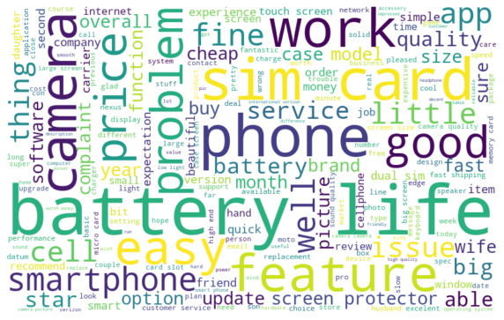
Word cloud for positive reviews

Slide 17
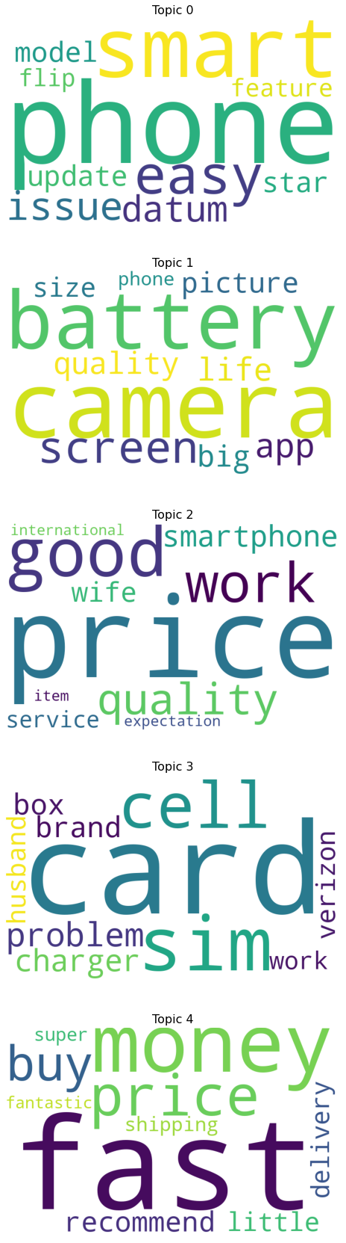
Word cloud for each topic in positive reviews

Slide 18
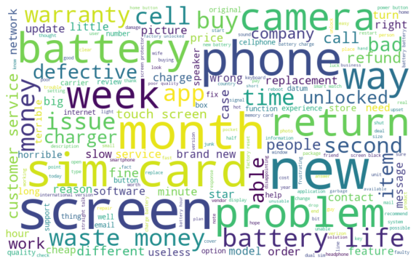
Word cloud negative reviews

Slide 19
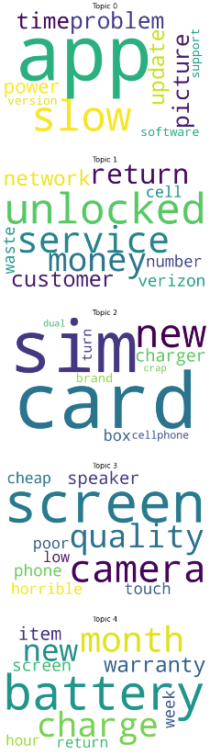
Word cloud for each topic in negative reviews

Slide 20
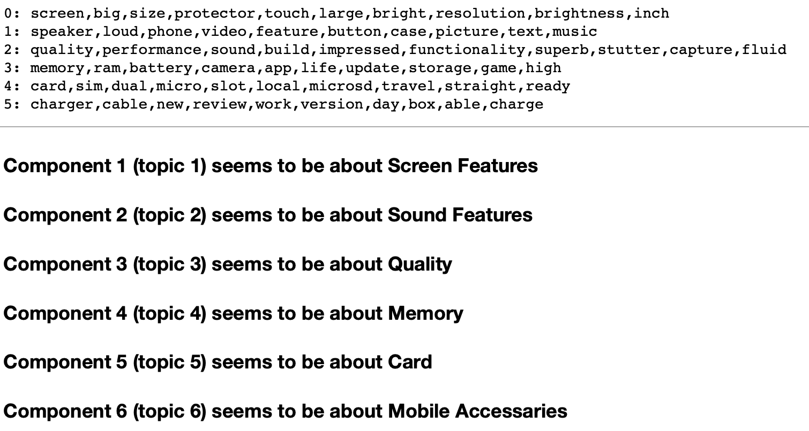
CorEx

Slide 21
Clustering
By performing clustering on positive reviews and negative reviews separately, we found unequal latent dimensions between these two categories.
Positive reviews can be represented sufficiently by only two latent dimensions whereas negative reviews could be represented by more than two latent dimensions with very low overlap.

Slide 22
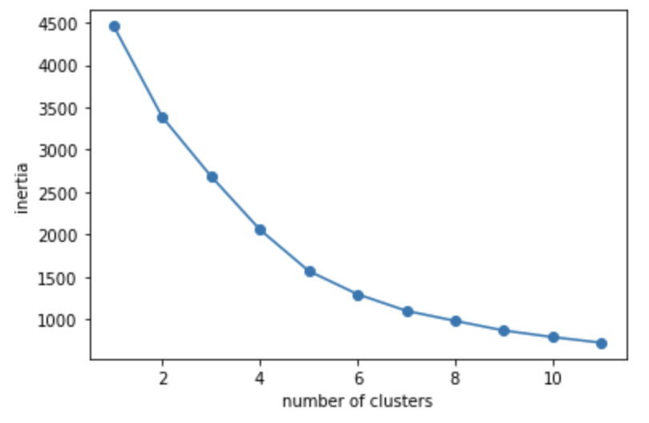
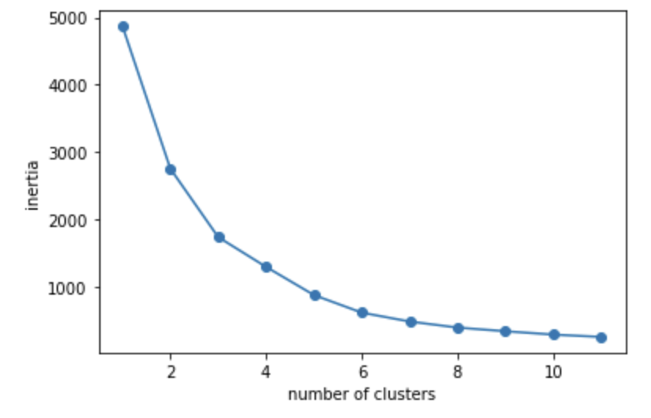
Elbow Differences between Positive and Negative Reviews
Positive Reviews
Negative Reviews

Slide 23
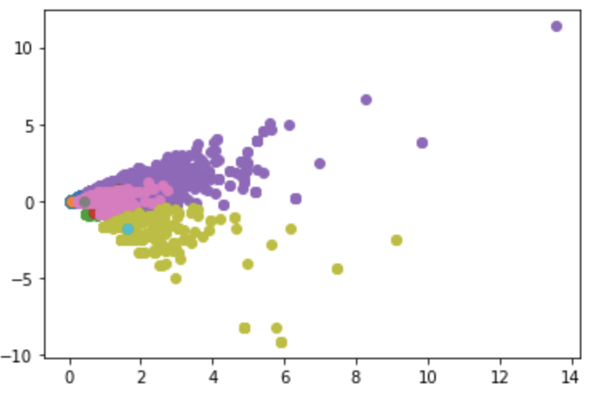
Positive Reviews (K-Means)
Positive Reviews with 5 latent dimensions.
Obvious overlap among clusters in higher dimensions.

Slide 24
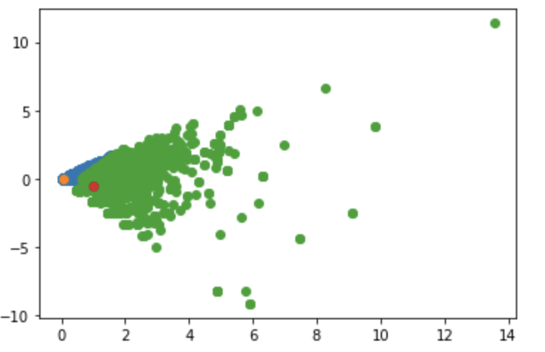
Positive Reviews (K-Means)
Positive Reviews with only 2 latent dimensions/components.
Very low overlap and the two latent dimensions are quite separable.

Slide 25
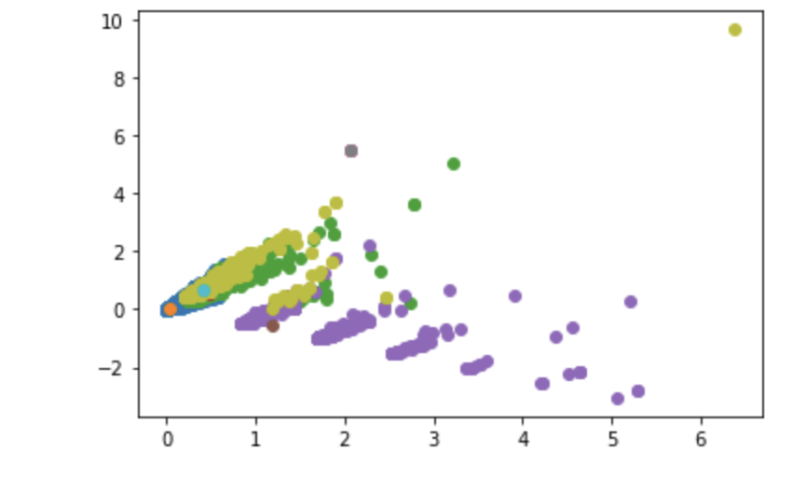
Negative Reviews(K-Means)
Negative reviews contain more latent dimensions/components that contain very low overlap.

Slide 26
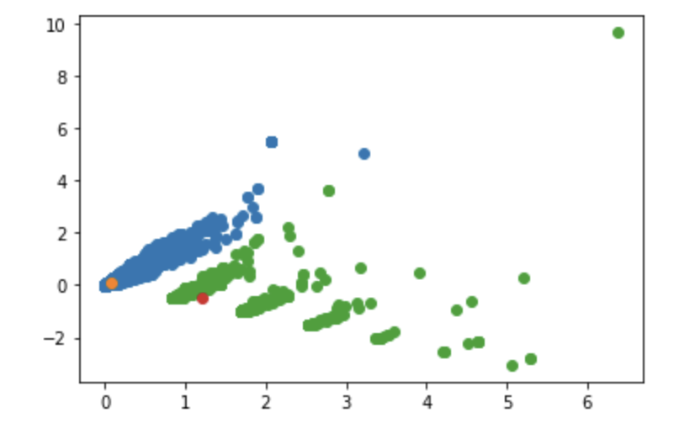
Negative Reviews (K-Means)
Negative reviews could be fully represented by only two latent dimensions/components.

Slide 27
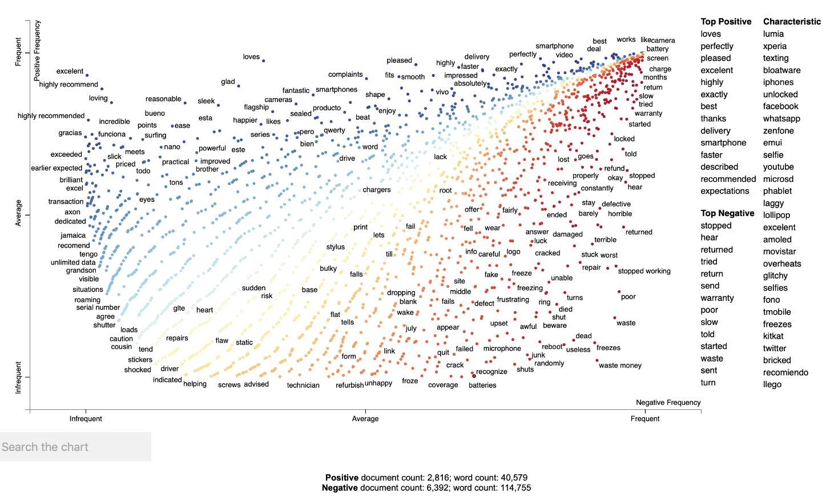
Scatter Text

Slide 28
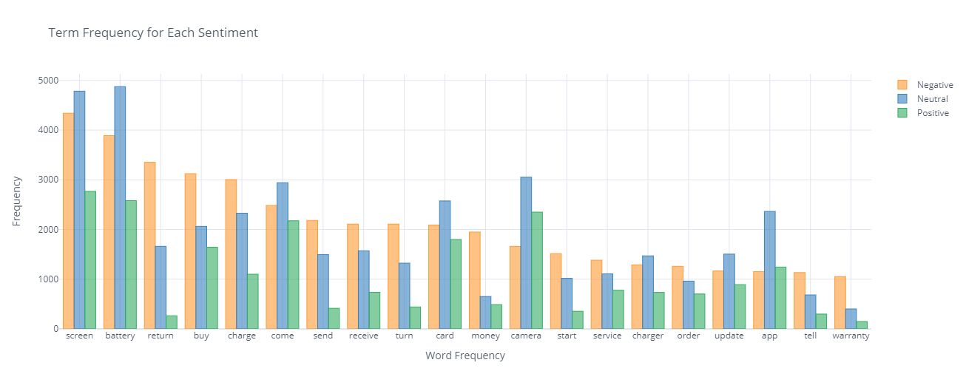
Term Frequency for Each Sentiment

Slide 29
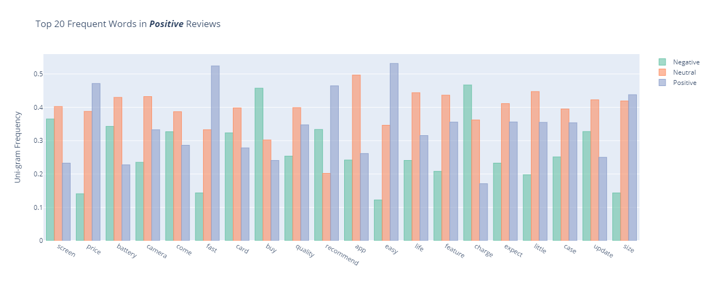
Uni-gram Frequency (Positive Reviews)

Slide 30
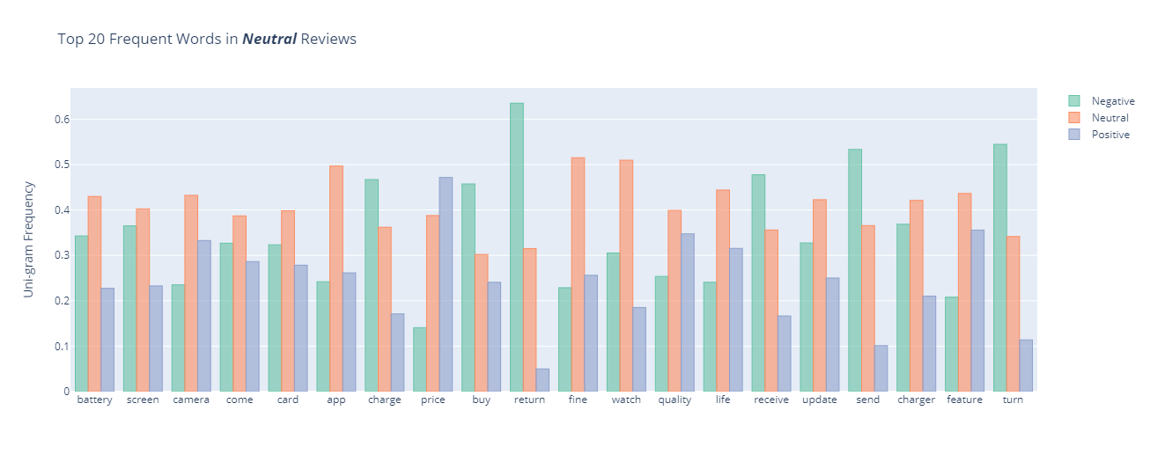
Uni-gram Frequency (Neutral Reviews)

Slide 31
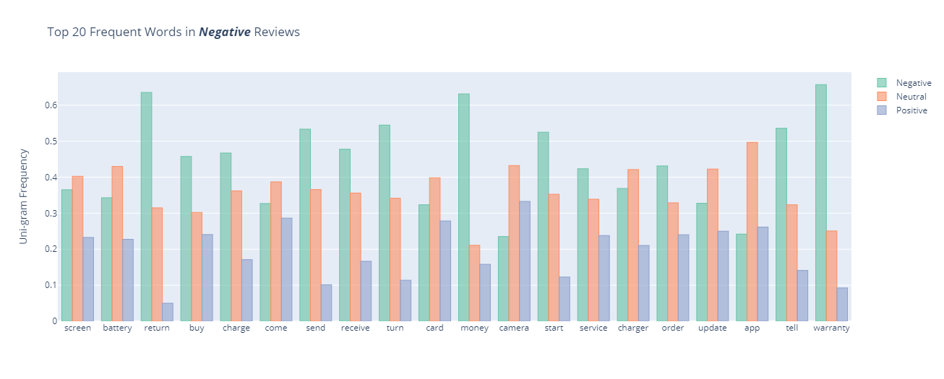
Uni-gram Frequency (Negative Reviews)

Slide 32
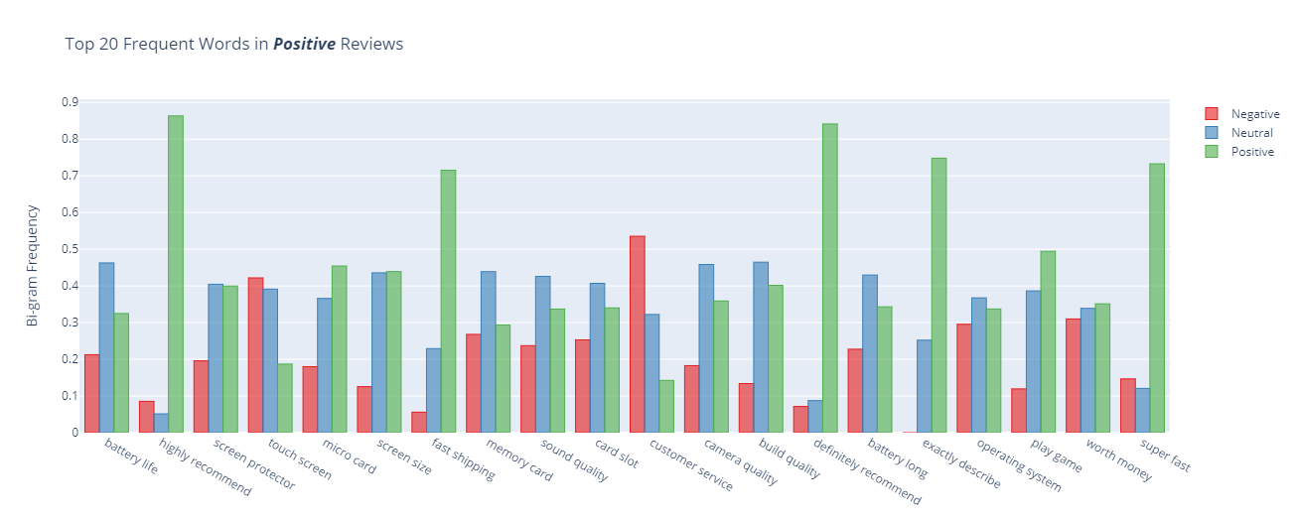
Bi-gram Frequency (Positive Reviews)

Slide 33
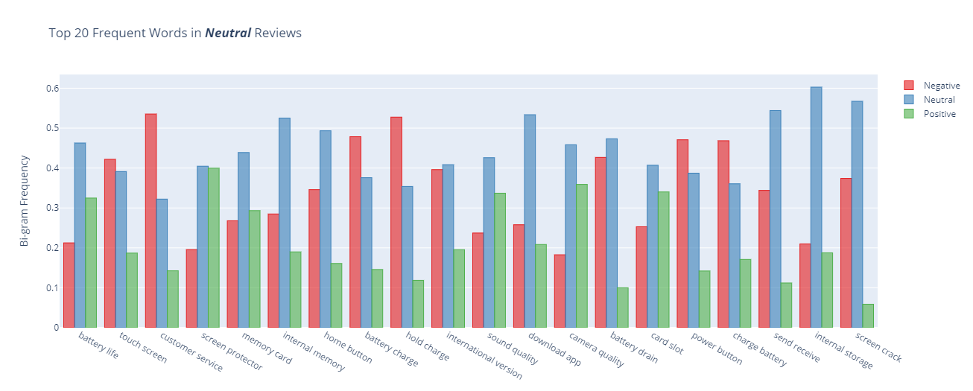
Bi-gram Frequency (Neutral Reviews)

Slide 34
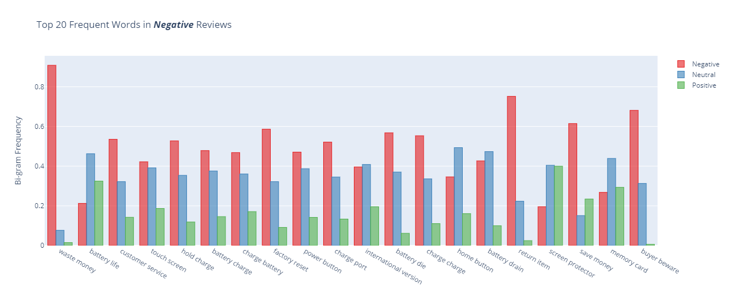
Bi-grams Frequency (Negative Reviews)

Slide 35
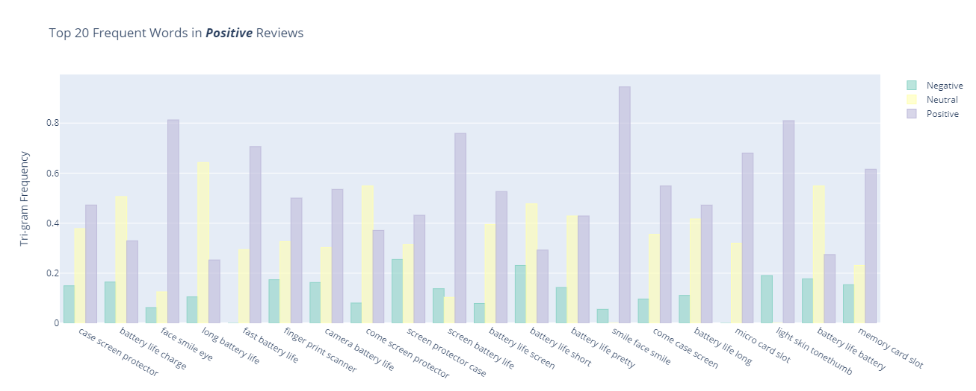
Tri-gram Frequency (Positive Reviews)

Slide 36
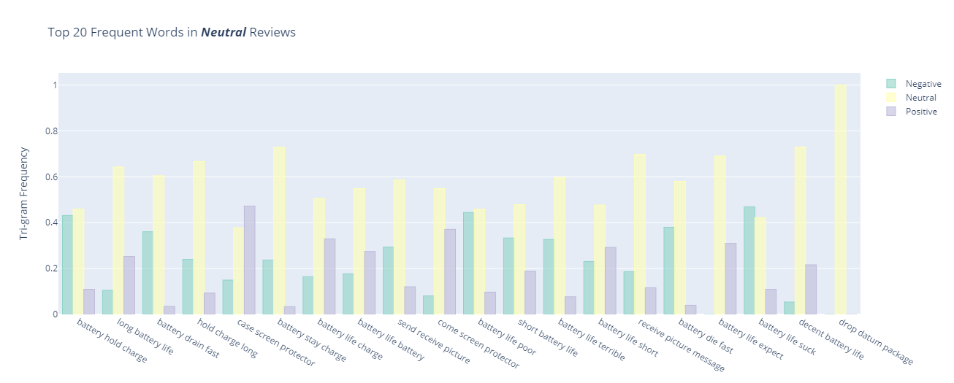
Tri-gram Frequency (Neutral Reviews)

Slide 37
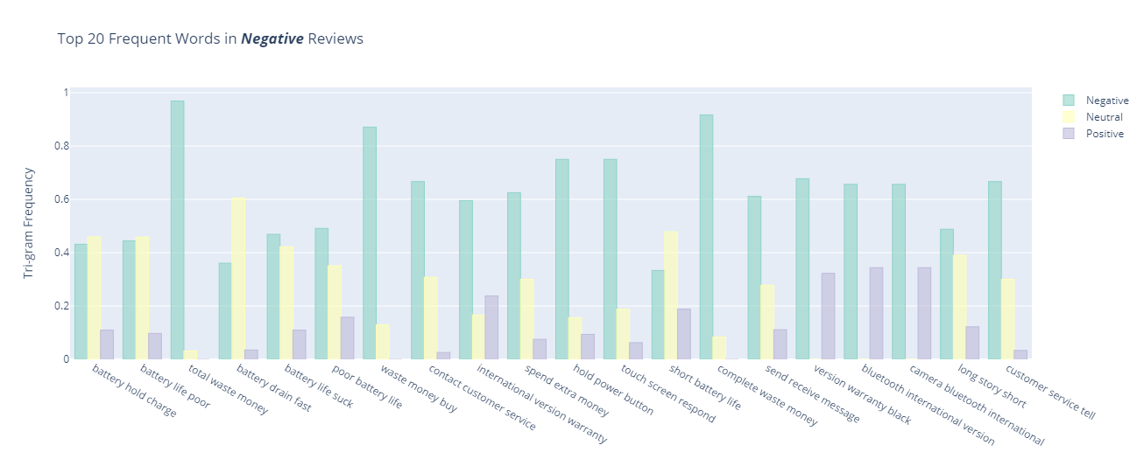
Tri-grams Frequency (Negative Reviews)

Slide 38
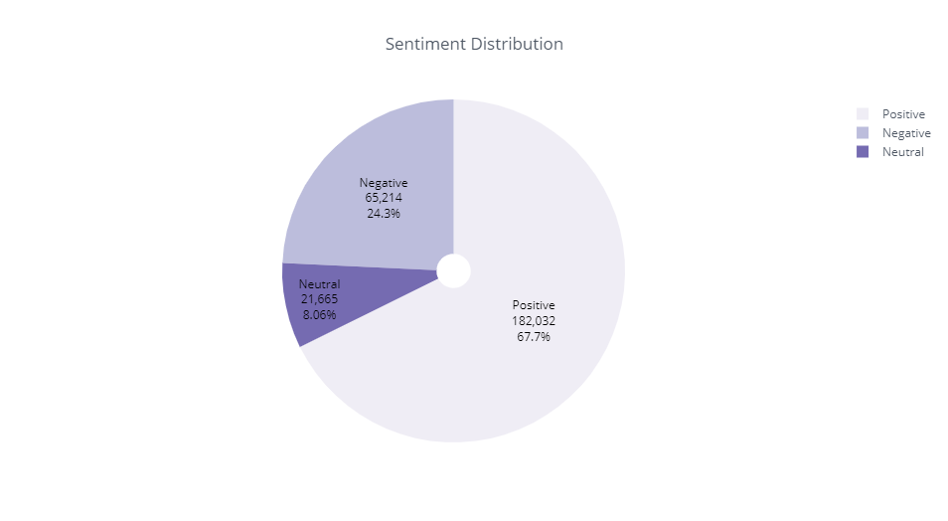
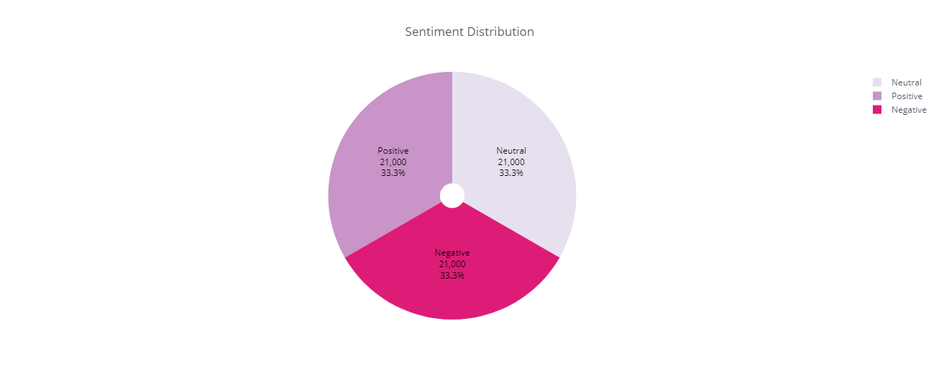
Data before and after sampling

Slide 39
Classification
Logistic regression | Accuracy | precision | Recall | F1-score
Train | .76 | .80 | .79 | .79
Val | .69 | .69 | .69 | .68
Train-no noise | .76 | .77 | .76 | .76
Val –no noise | .68 | .68 | .68 | .67
Train-ngrams | .85 | .86 | .85 | .85
Val-ngrams | .71 | .72 | .71 | .71
Train-Trigrams | .86 | .87 | .86 | .86
Val-Trigrams | .72 | .72 | .72 | .71
.

Slide 40
Classification
SGB Classifier | Accuracy | precision | Recall | F1-score
Train | .74 | .75 | .74 | .73
Val | .67 | .67 | .67 | .66
Train-no noise | .71 | .73 | .71 | .70
Val-no noise | .64 | .65 | .64 | .63
Train -ngrams | .69 | .71 | .69 | .68
Val-ngrams | .69 | .64 | .64 | .63
Train-unigrams | .79 | .81 | .79 | .79
Val-unigrams | .69 | .70 | .69 | .68

Slide 41
Classification
Niave Bayes | Accuracy | precision | Recall | F1-score
Train | 0.64 | .66 | 0.64 | 0.64
Val | 0.59 | .61 | 0.59 | 0.59
Train-no noise | 0.61 | 0.63 | 0.61 | 0.61
Val-no noise | 0.58 | 0.59 | 0.58 | 0.57
Train -ngrams | 0.67 | 0.70 | 0.67 | 0.67
Val-ngrams | 0.61 | 0.63 | 0.61 | 0.60
Train-unigrams | 0.65 | 0.70 | 0.65 | 0.65
Val-unigrams | 0.59 | 0.63 | 0.59 | 0.58

Slide 42
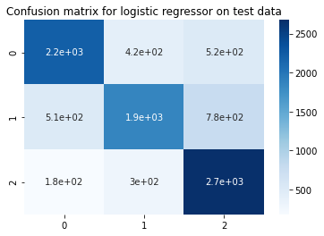
The best Classifier is Logistic Regressor with Trigram:
Train Accuracy :
.86
Test Accuracy:
.71

Slide 43
Future work
Enhancing machine learning pipeline for better NLP text processing.
Trying stacking classifiers and ensemble classifiers on reduced NLP dataset.

Slide 44
Thank you for listening ☺

